Slide 1

Holmusk – Health Analytics Report
Shivaram Andiappan Selvaraj

Slide 2
Problem description
To analyze the clinical and financial data of patients hospitalized for a certain condition
To find insights about the drivers of cost of care

Slide 3
Data Engineering, Feature Engineering and Data Imputation
Four Datasets Bill amount, Bill id, Demographics and Clinical data are joined by left join query using bill id and patient id columns as join key.
The missing data in Medical history 2 and medical history 5 variables are imputed using mode of those variables as they being categorical data type
Variable | Formula
BMI | Weight in Kg / Height *Height in meters
Age | Date of Birth - Current Date
Days spent in hospital | Discharge Date - Admission Date

Slide 4
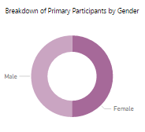
Insights
Breakdown of Participant by Gender:
49.94% are male
50.06% are female

Slide 5
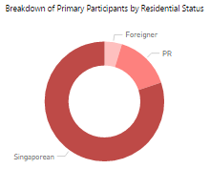
Insights
Breakdown of Participant by Resident Status:
80.12% are Singaporean
15.5% are Singapore PR holder
4.74% are Foreigners

Slide 6
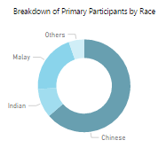
Insights
Breakdown of Participant by Race:
63.71% are Chinese
20.79% are Malay
10.12% are Indians
5.38% are Others

Slide 7
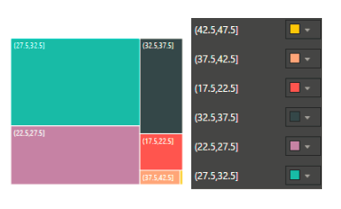
Insights
BMI Analysis:
More than 50% population are either in Overweight or Obesity category
BMI Index range | Count | Health Condition
17.5-22.5 | 212 | Healthy Weight
22.5-27.5 | 1025 | Healthy Weight
27.5-32.5 | 1527 | Overweight
32.5-37.5 | 553 | Obesity
37.5-42.5 | 78 | Obesity
42.5-47.5 | 5 | Obesity

Slide 8
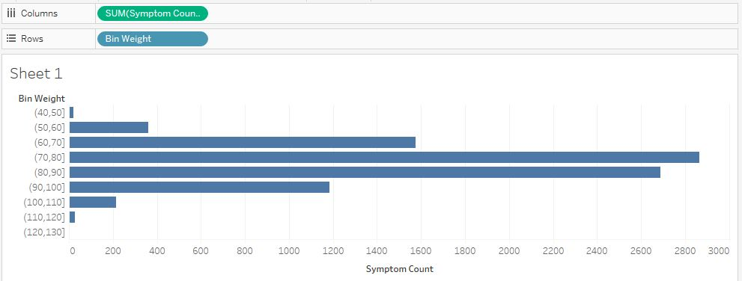
Insights
Analysis on Weight and Symptoms
Patients with weight in the range of 70-80 have maximum number of Symptoms. More symptoms leads to more diseases. So these patients are more risk prone

Slide 9
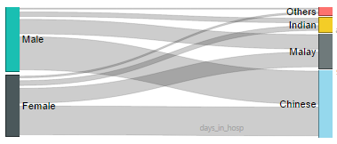
Insights
Gender | Race | Amount
Male | Chinese | 22.11 M
 | Malay | 10.29 M
 | Indian | 03.98 M
 | Others | 01.73 M
Female | Chinese | 19.30 M
 | Malay | 10.57 M
 | Indian | 04.16 M
 | Others | 02.18 M
The above Sankey diagram shows a clear visualization for drivers of cost between Gender and Race variable
Flow of Medical Expense between Gender and Race:

Slide 10
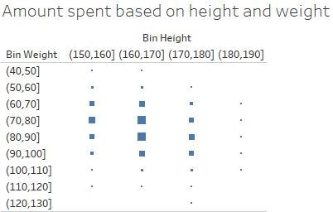
Insights
Medical expense based on Height and Weight of patient:
Patients with weight between 70-80 kgs and height between 160-170 cm are one of the major drivers of medical expense

Slide 11
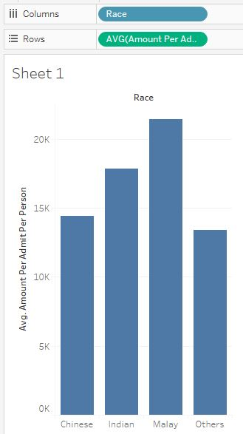
Insights
Average expense based on Race:
Even tough Chinese race contributes to major part of the population, It is Malay race which consumes major part of Medical expense

Slide 12
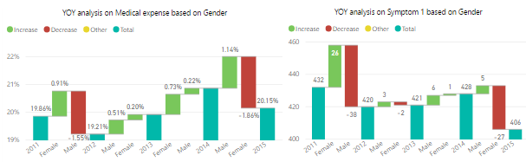
Insights
Gender affects Medical expense:
The cost of medication is more or less constant in all the given years with slight a slight upward trend. When it is analysed in depth based on a gender basis, we came to know that the amount incurred has been in constant rise for the male whereas there are some falls for the female. So in order to support this the second chart shows the count of Symptom1 based on a gender. It also shows that women category has three falls whereas men category does not have a fall at all. From this it is clear that Men is a driving factor for rising cost. A remedy for this would be to prevent Men from diseases prior to Women

Slide 13
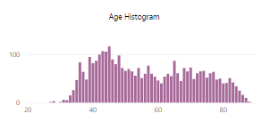
Insights
Age - a major factor for Patient’s sickness:
The Histogram above shows the count of all age groups of patients who got admitted so far. The maximum number of patients are from the Age group of 40-50
Age | Count
45 | 117
43 | 107
44 | 106
42 | 100

Slide 14
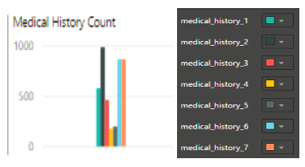
Insights
Medical History Analysis:
Patients are mostly having Medical History 2 followed by Medical History 6 and 7. In the future unaffected people should be screened or prevented from this particular disease
Medical History | Count
1 | 575
2 | 986
3 | 463
4 | 177
5 | 198
6 | 866
7 | 865

Slide 15
Insights
Pre-op Medication Analysis:
Pre-op medication 3,5 and 6 are the top three medications done before any surgery. So corresponding doctors should be scaled according the requirement for undisrupted work. Consider Pre-op medication 3 as Anesthetist who gives Anesthesia before surgery. Then it is ideal to have more Anesthetist compared to other doctors. This would enable efficiency in medical workforce
Pre-op Medication | Count
1 | 1713
2 | 2010
3 | 2791
4 | 1779
5 | 2787
6 | 2530

Slide 16
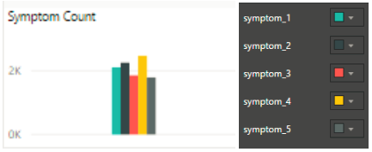
Insights
Symptom Analysis:
Most people are suffering from Symptom 4 and Symptom 2. These symptoms leads to certain diseases. For example let Symptom 4 be ‘Fatigueness’ and Symptom 2 be ‘sudden dizziness’. They both are symptoms for Heart attack. Patients who fall under both system should be monitored for Heart diseases
Symptom | Count
1 | 2107
2 | 2252
3 | 1852
4 | 2470
5 | 1791

Slide 17

Insights
BMI Average:
The Body Mass Index ranges from a minimum of 17.51 to a maximum of 46.68 with average being 28.96 which in turn falls into ‘Overweight’ category’. A BMI between 18.5 and 25 is a ‘Healthy Weight’ category. In order to reach the healthy BMI, patients should be asked to reduce their weight according to their height.

Slide 18

Insights
Days spent in Hospital Average:
A patient occupies a room in hospital with 1 day being the least and 20 days being the maximum. This information could be useful in finding the room occupation by patients and plan the allocation of rooms to patients efficiently in advance.

Slide 19
Insights
Market Basket Analysis:
Medical History, Symptoms and Pre op medication variables are used in MBA to find top relationships between these variables. Some of the rules are mentioned below.
Association rule 1: So from above table it is clear that a patient has medical history 4 and medical history 5 should undergo pre op medication 6
Association rule 2: A patient with medical history 4, medical history 5 and symptom 3 will have to undergo pre op medication 3

Slide 20
Insights
Market Basket Analysis:
LHS | RHS | Support | Confidence | Lift | Count
{medical_history_4, medical_history_5} | {preop_medication_6} | 0.002941176 | 1 | 1.343874 | 10
{medical_history_4, medical_history_5, symptom_3} | {preop_medication_3} | 0.001470588 | 1 | 1.218201 | 5

Slide 21
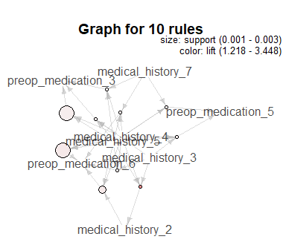
Insights
Market Basket Analysis:

Slide 22
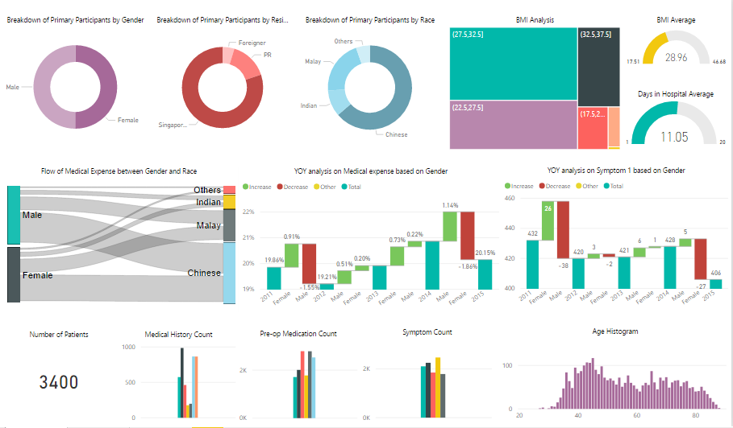
Dashboard

Slide 23
Thank You

